Slide 1
Scalability & Resilience in a Cloud-Native Microservice
Mayank Tamakuwala
CS 6650 – Building Scalable Distributed Systems
March 2026
AWS ECS Fargate · ALB · CloudWatch · Locust

Slide 2
System Architecture
Components
• ECS Fargate - serverless containers
(no EC2 management)
• Application Load Balancer
(distributes traffic across tasks)
• Auto Scaling - CPU target 70%
(scales 2 → 4 tasks under load)
• CloudWatch - real-time metrics
(CPU, Memory, RPS, Latency)
• Locust load testing
(progressive: 500 → 3000 users)
👤 Users
↓
Application Load Balancer
↓
ECS Cluster
→
⚡ Auto Scaling (CPU > 70%)
→
📈 Scale Out (2→4 Tasks)
Task 1
Task 2
Task 3
Task 4
📊 CloudWatch — CPU · Memory · RPS · Latency

Slide 3
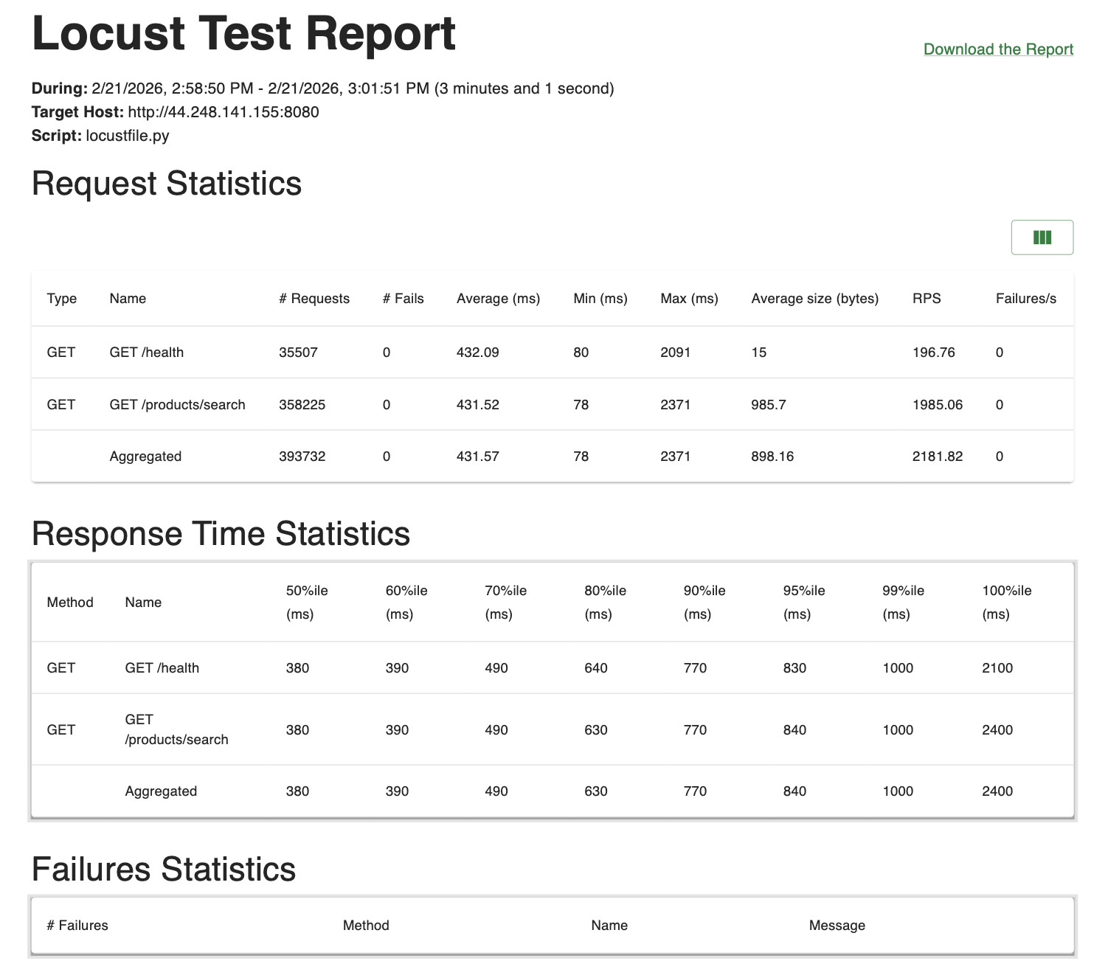
Stress Testing Setup
Test Parameters
• Progressive load ramp-up strategy
• Simulated users: 500 → 3,000
• Requests per second: 50 → 200
• Spawn rate: 10 users/second
• Metrics observed:
– CPU utilization
– Memory usage
– Requests per second (RPS)
– Response latency (avg & p95)
– Failure count & rate
• Tool: Locust (Python-based)

Slide 4
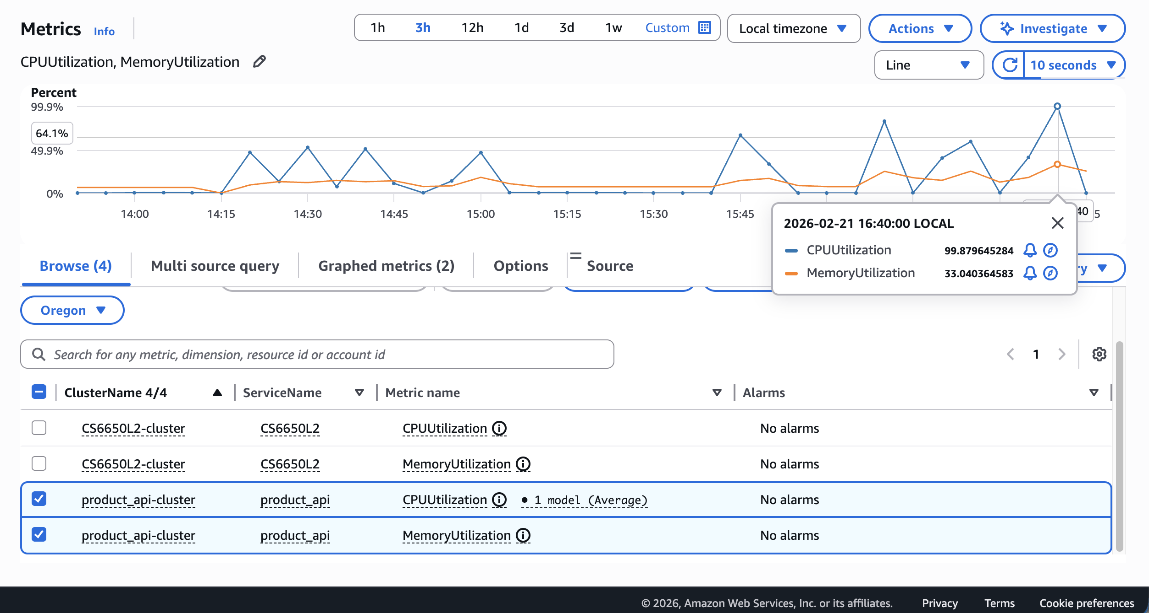
CPU-Bound Bottleneck
Observation:
• CPU saturated at ~99%
under heavy load
• Memory remained stable
(~30%) - NOT the bottleneck
• Throughput plateau:
RPS stops growing despite
more simulated users
• Latency climbed sharply
as CPU queues built up
Diagnosis:
The service is CPU-bound.
Solution → Horizontal Scaling
CPU ≈ 99%
Memory
Throughput
~30% ✔ Stable
Plateau ✘ Flat

Slide 5
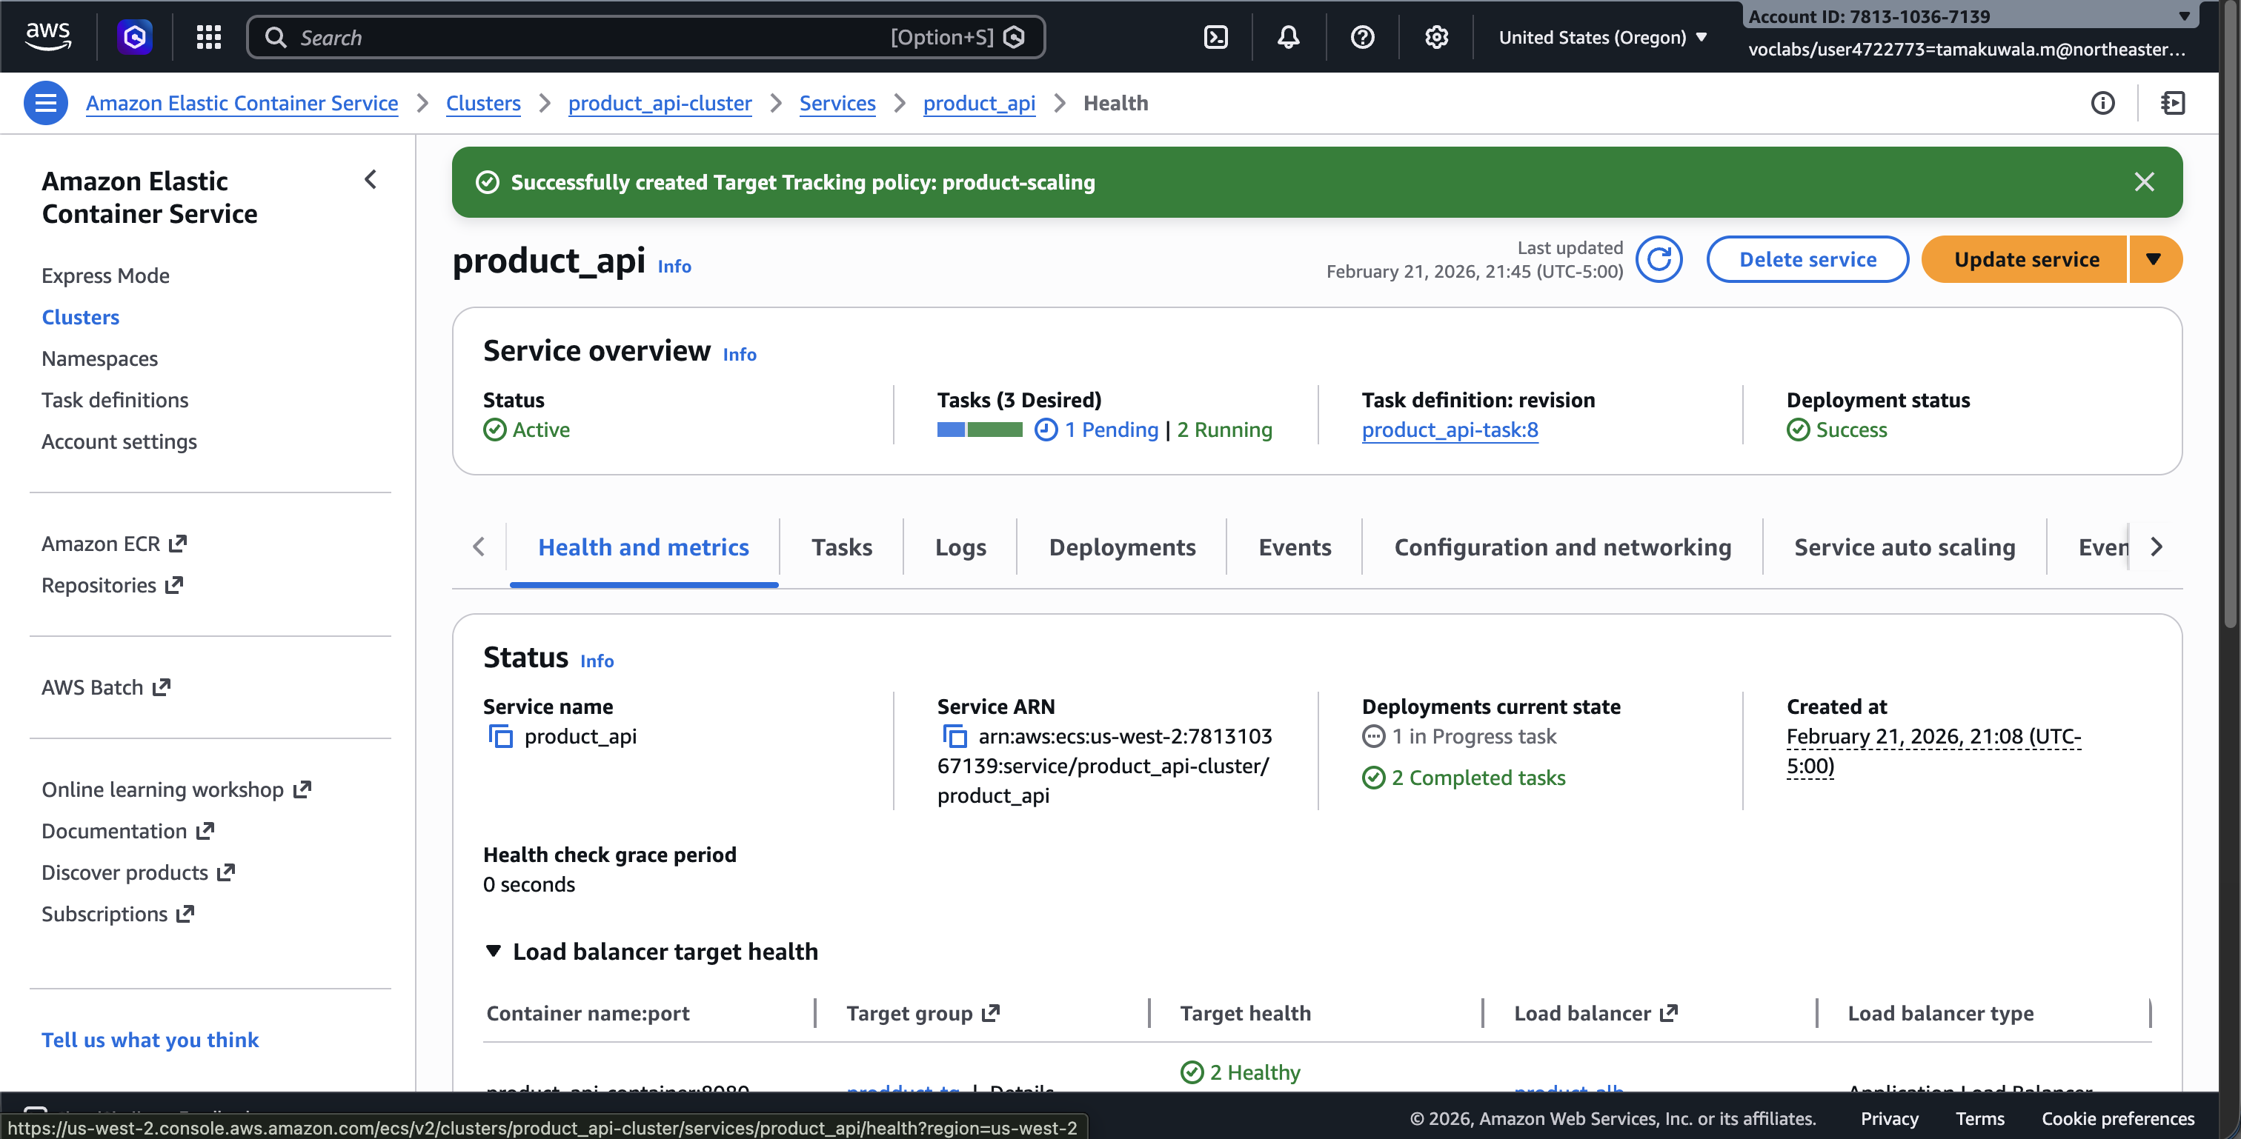
Auto Scaling in Action
What Happened:
• Under load, CPU crossed 70%
threshold (Auto Scaling policy)
• ECS scaled out:
Desired count 2 → 3
Running tasks 2 → 3
• Load distributed across
3 containers
• CPU per task decreased
after new task launched
• Elasticity proven:
System adapts automatically
without manual intervention
2 Tasks
→
3 Tasks

Slide 6
Resilience Test: Self-healing Under Task Failure
Scenario
Service running under sustained load
Multiple ECS tasks active behind ALB
Failure Injection
Manually terminated one running ECS task
Simulated unexpected container crash
System Behavior
ECS detected stopped task automatically
Replacement task launched to maintain desired count
ALB redistributed traffic to healthy targets
No service outage observed
Key Insight
Container orchestration enables automatic recovery
System remains available despite instance-level failure

Slide 7
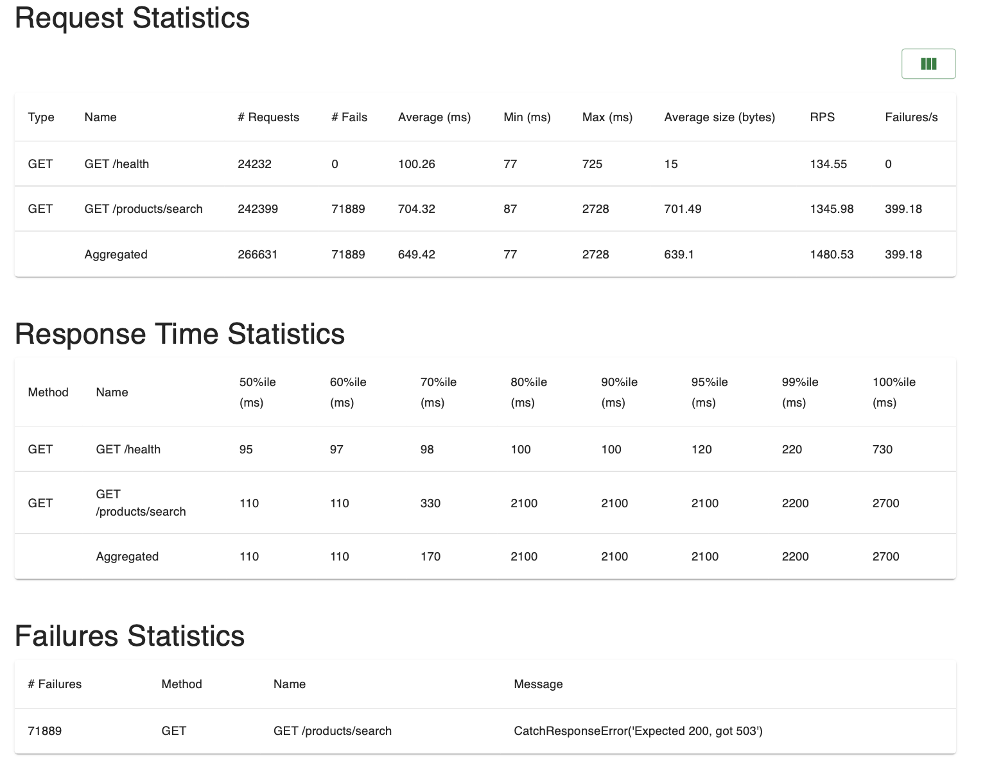
Downstream Dependency Failure
fakeExternalService (Broken Mode)
Effect:
• 30% of requests delayed by 2s
• Cascading latency spike
• p95 latency becomes unpredictable
• System appears slow even when CPU load is moderate
Root cause: unbounded wait on a slow downstream service
func fakeExternalService() error {
// 30% chance of slow response
if rand.Float64() < 0.30 {
// Simulate downstream delay
time.Sleep(2 * time.Second)
return nil
}
return nil
}
// Called in every request handler:
if err := fakeExternalService(); err != nil {
http.Error(w, err.Error(), 500)
}
• 30% of requests hit a 2-second sleep
• No timeout cap → goroutines pile up
• Resources exhausted under load

Slide 8
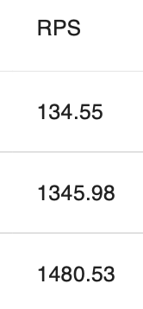

Applying Fail-Fast Resilience Pattern
fakeExternalService → With Timeout (Fixed)
Why Fail-Fast Works:
• Caps waiting time at 200 ms
• Prevents goroutine pile-up
• Returns HTTP 503 immediately
instead of timing out the client
• Frees CPU/memory for healthy reqs
• Latency becomes predictable
func fakeExternalServiceWithTimeout(
timeout time.Duration) error {
done := make(chan error, 1)
go func() {
time.Sleep(2 * time.Second)
done <- nil
}()
select {
case err := <-done:
return err
case <-time.After(timeout):
return errors.New("timeout")
}
}
// Called with 200ms cap:
fakeExternalServiceWithTimeout(200 * time.Millisecond)
Broken Mode
Fixed Mode
→

Slide 9
Before vs After - Quantitative Comparison
Metric
Broken Mode
Fixed Mode
Avg Latency
High (2+ seconds)
Low (<300 ms)
p95 Latency
Very High (4–6s+)
Controlled (<500 ms)
RPS
Drops / unstable
Stable & consistent
Error Type
Slow client timeout
Fast HTTP 503
Resource Use
Goroutine pile-up
Goroutines freed fast
UX Impact
Long waiting / hung
Quick error, retry ok
Analytical outcome: Fail-Fast pattern eliminates cascading slowdowns while preserving system throughput.

Slide 10
Key Takeaways
📊
Metrics-Driven Diagnosis
🔎
CPU-Bound Bottleneck Identified
Use CPU, memory, RPS, latency together — not in isolation.
Memory stable; only CPU saturated → pinpoint root cause.
⚡
Horizontal Scaling = Elasticity
🛡
Self-Healing Containers
ECS auto-scaling absorbed load increases automatically.
ECS restarted crashed tasks with no manual intervention.
🚀
Fail-Fast Prevents Cascades
☁️
Cloud-Native Design Pays Off
200 ms timeout cap stopped slow dependency from starving resources.
Managed services (Fargate, ALB, CloudWatch) reduce ops burden.
"Scalability is not just adding resources — it's designing for failure."

